Slide 1
Open-source Holistic Social Network Analysis Portal
A Business Intelligence Application for Counter-Terrorism and Law Enforcement
Philip A Grim II
CISC525

Slide 2
Overview
Purpose
Design
Implementation
Conclusion

Slide 3
Purpose
Demonstrate Business Intelligence Techniques Applied to Counter-Terrorism
Data Mining
Text Mining
Web Mining
Text Analytics
Artificial Intelligence Techniques
Statistical and Graphical Analysis

Slide 4
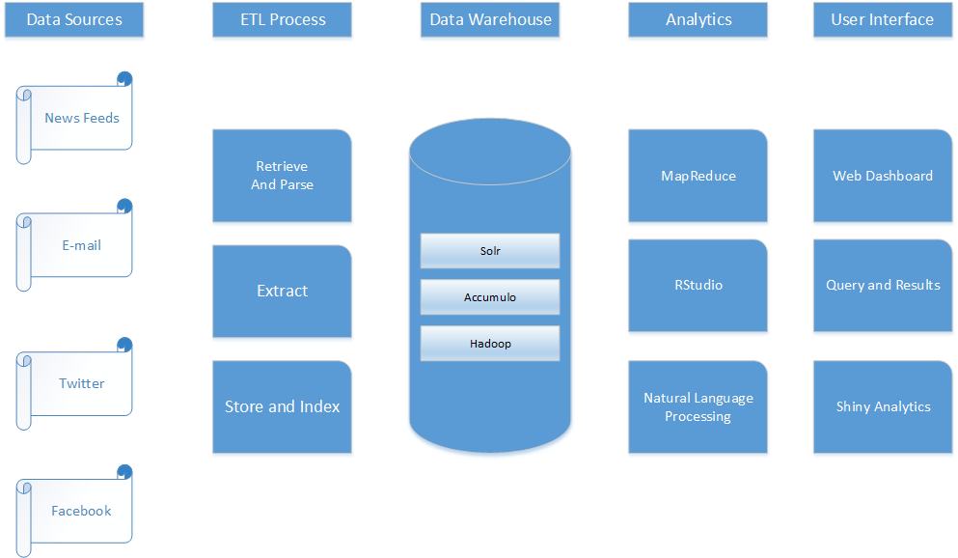
Logical Design - Architecture

Slide 5
Logical Design - Tools
Apache Hadoop
Apache Accumulo
Apache Zookeeper
Apache Solr
Apache Mime4J
Apache HTTPD
Apache Tomcat
R Statistical Programming Language
raccumulo
RStudio
Shiny Server
JASIG Common Authentication Service (CAS)
General Architecture for Text Engineering (GATE)
Stanford CoreNLP
Notes:
The demonstration system is built on open source tools including the following:
Apache Hadoop – An open-source implementation of Google’s distributed file system and MapReduce programming framework.
Apache Accumulo – An open-source implementation of Google’s Big Table NoSQL data store that integrates with Hadoop and provides a column-oriented secure database.
R Statistical Programming Language – An open-source implementation of the S language for statistical programming.
General Architecture for Text Engineering (GATE) – An open-source framework for implementing text analytics, from University of Sheffield
Stanford Natural Language Processing – An open-source NLP implementation from Stanford University.
Apache Mime4J – A Java implementation of the RFC-822 specification for e-mail handling.
raccumulo – An open source package developed by the author to allow the R programming language to access an Accumulo data store.
RStudio – an integrated development environment (IDE) for programming and analytics using R.
Apache HTTPD – An open-source web server.
Apache Tomcat – An open-source servlet container.
Shiny Server – An open-source extension for the R language that provides the capability to publish interactive visual analytics as web applications.
Apache Solr – A distributed indexing system that provides full text and temporal indexing of text data.
JASIG Common Authentication Service (CAS) – An open-source single sign-on server for web applications.

Slide 6
Logical Design – Data Sources
Open Source news sources
Gathered using web mining techniques such as RSS feed harvesting.
E-mail and text messages
Agencies generally capture this data from mail servers, captured laptops, and captured cell phones. These are normally taken from apprehended suspects during investigations.
Social Media
Includes Facebook and Twitter data.

Slide 7
Logical Design - Questions
What are the sources of data available to the agent?
Who are people of interest in the data set?
Who are the suspicious individuals talking to?
What topics are popular in the discussions between suspicious individuals?
What is the tone of the conversations the individuals are having?
What events are happening that might point to suspicious activity?
How are the individuals of interest related to the events of interest?
What topics are popular in news sources related to events of interest?
What is the tone of the news reporting about events of interest?
What topics are other agents interested in?
How much data supports the various questions being asked?
Notes:
This demonstration was largely inspired by the Chapter 7 Opening Vignette from the Turban text. This case study, “Mining Text for Security and Counter Terrorism”, is very closely associated with the author’s life work. This demonstration illustrates some of the ways text mining, text analysis, and other analytic techniques support the mission of protecting against terrorism as discussed in this case study.
Application Case 7.4, “Flying through Text”, also applies to this demonstration. In that case study, AerLingus used text mining techniques to study incident reports, extracting time, location, and other relevant data. Counter-terrorism analysts use similar techniques to find suspicious events in news reporting and intelligence reports, and link individuals to those events.
Application Case 5.2, “Law Enforcement Organizations Use Data Mining to Better Fight Crime”, also illustrates some of the kinds of questions that counter-terrorism agents ask, and the techniques that can help to answer them.

Slide 8
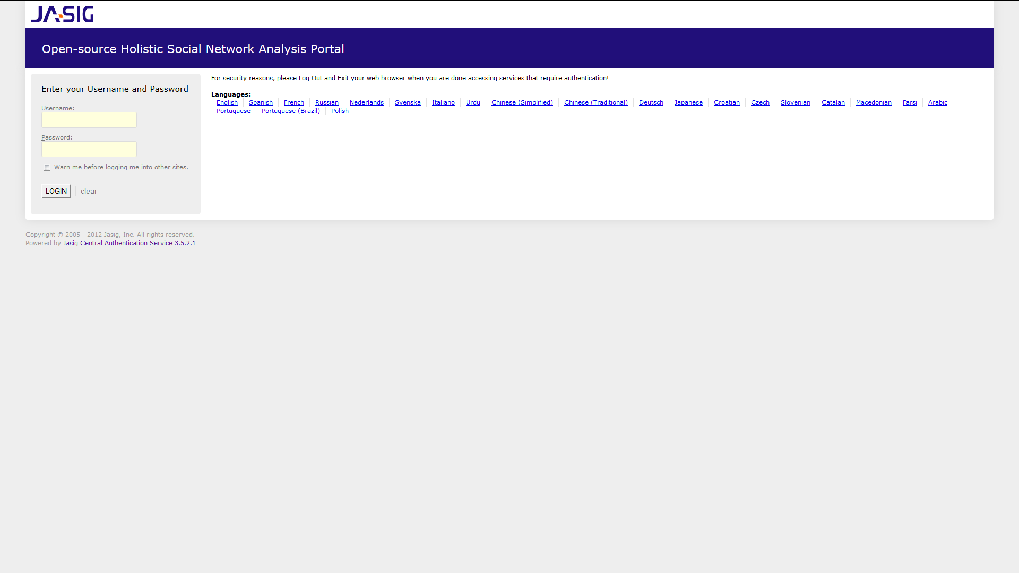
Implementation User Authentication
Notes:
Users connect to the BI Portal using a standard web browser. The application server requires users to authenticate prior to being allowed to access the portal. Authentication services are provided by a Common Authentication Service (CAS) server running in the same application server context as the portal itself.

Slide 9
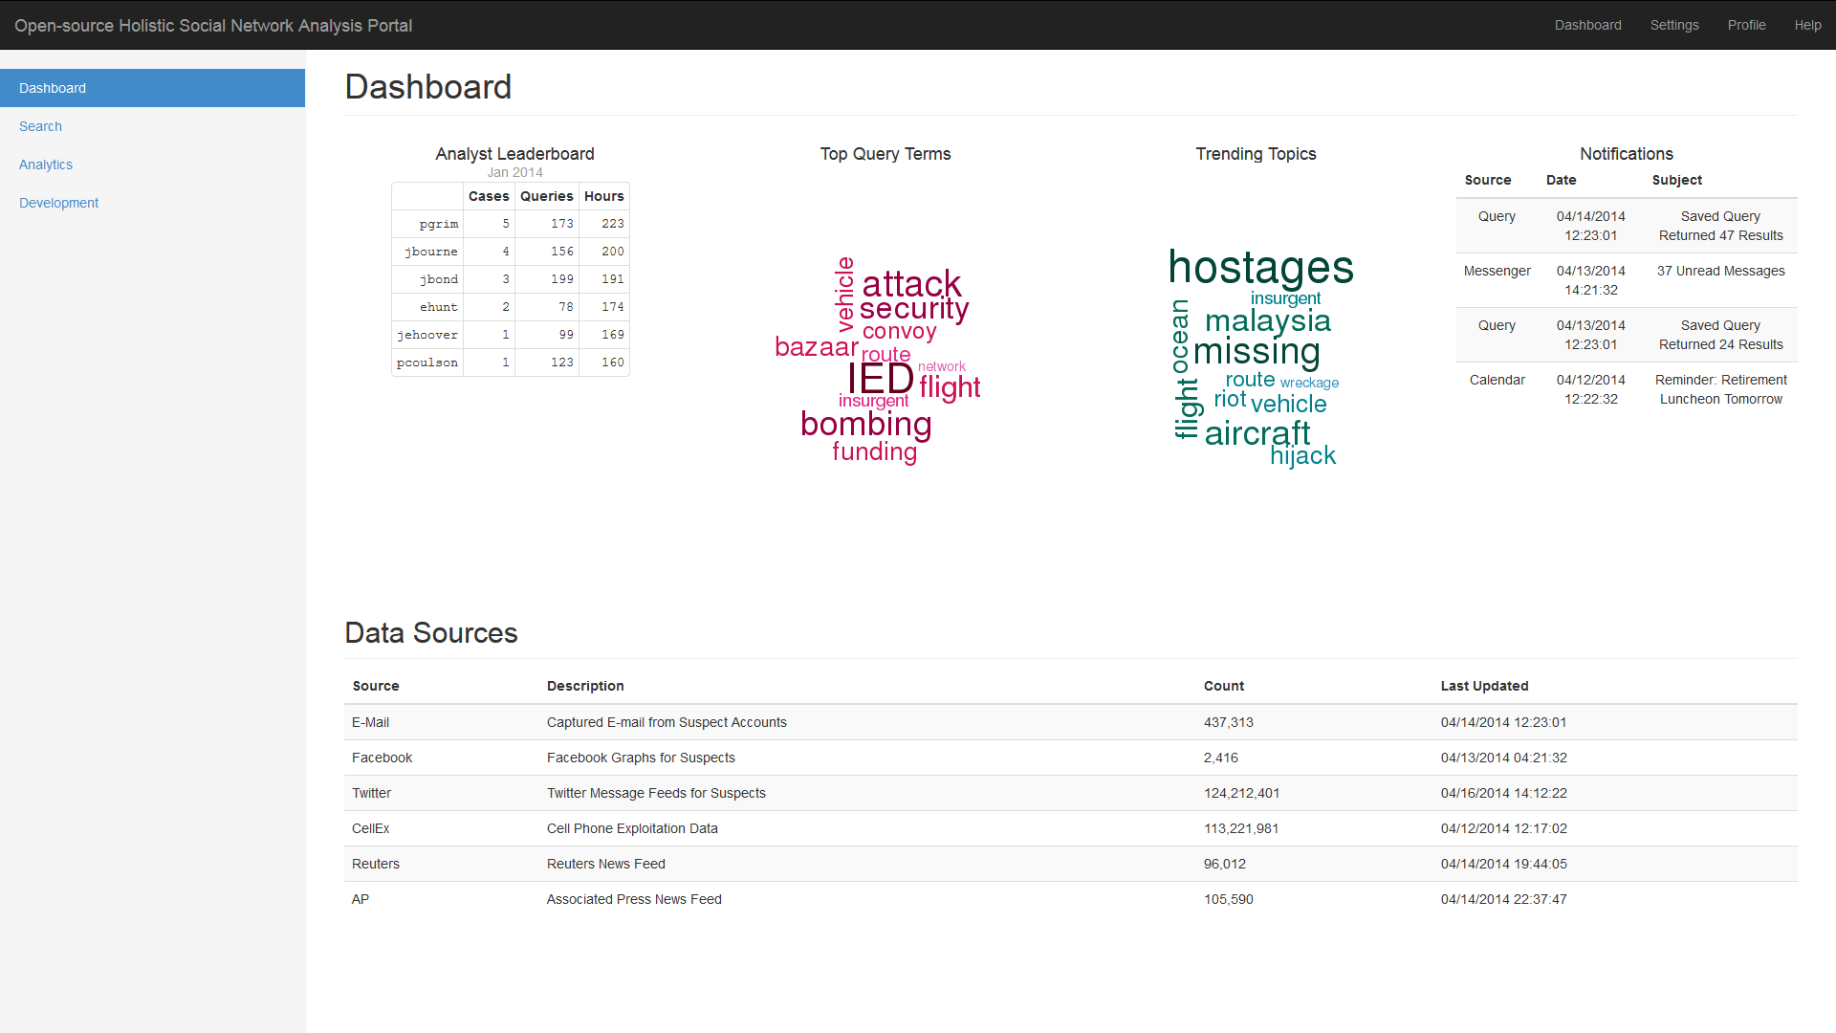
Implementation Dashboard
Notes:
The dashboard is the main entry point into the portal. The dashboard components provide an overview of the portal and the data available. This gives an overall “situational awareness” to the analyst at sign-on time. From here, the analyst can use the tools provided to search for information and perform analytics.
The main screen has several navigation elements to allow the analyst to access the features of the portal. The navigation bar across the top of the screen provides menus to change user preferences, access the user’s profile information, and access the help system, as well as a link to return to the dashboard. The main navigation menu on the left-hand side holds links to the dashboard, the search function, the analytics function, and the development tools.
The main work area of the Dashboard screen contains information to assist the analyst. The Analyst Leaderboard (top left) provides an element of gamification to the portal. It ranks analysts by the number of cases worked, the number of queries performed, and the number of hours spent researching.
The Top Query Terms column shows a word cloud representing the most frequently used words in searches. This visual representation changes based on the queries being performed by all of the analysts using the system. The larger the word in the cloud, the more popular the query term is.
The Trending Topics word cloud shows the most popular terms in the stored text data. This display updates as more data is ingested and analyzed. Again, the most popular terms are indicated in larger type.
The Notification area shows important messages waiting for the user, such as saved query results, messages from other analysts, and schedule alerts. The Data Sources table at the bottom of the panel shows the various sources of data being ingested into the system. The display includes the name and a brief description of the source, the number of messages ingested from that source, and the most recent message date in the source.

Slide 10
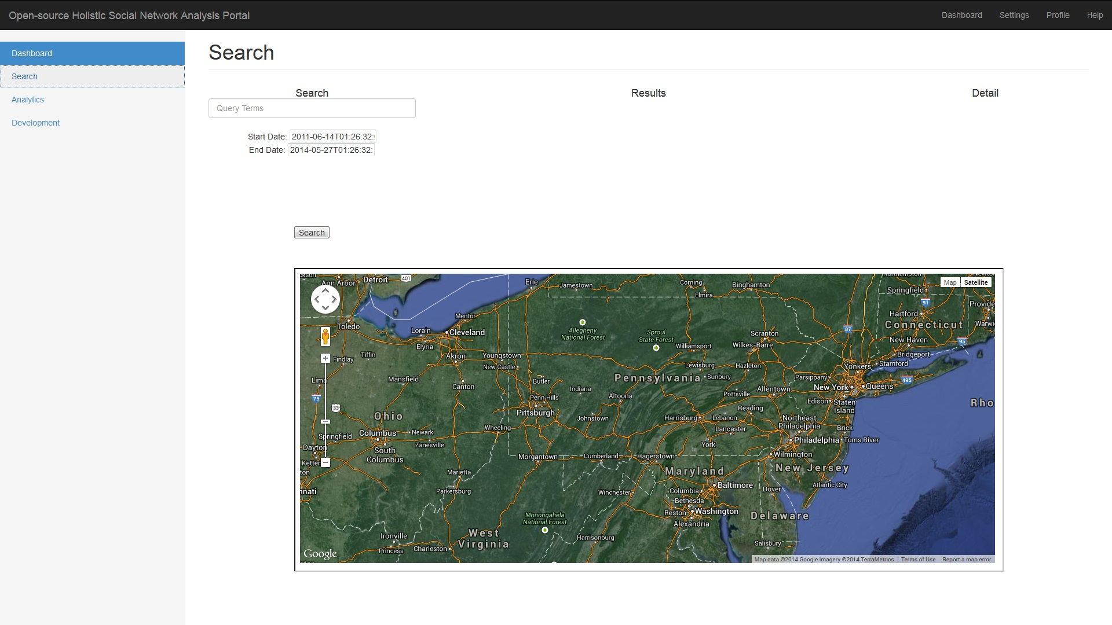
Implementation Search Panel
Notes:
The Search panel provides the analyst with the means to perform text, temporal, and spatial queries over the data in the data store.
The Search column show a text control for the user to enter the query terms. Beneath that, two date controls allow the user to specify a start and end date between which the results should fall. The map control at the bottom allows the user to draw a search polygon. Items with a geospatial component are indexed to allow searches to be limited by location, and this control specifies those limits. Once the query is built, the Search button executed the query.

Slide 11
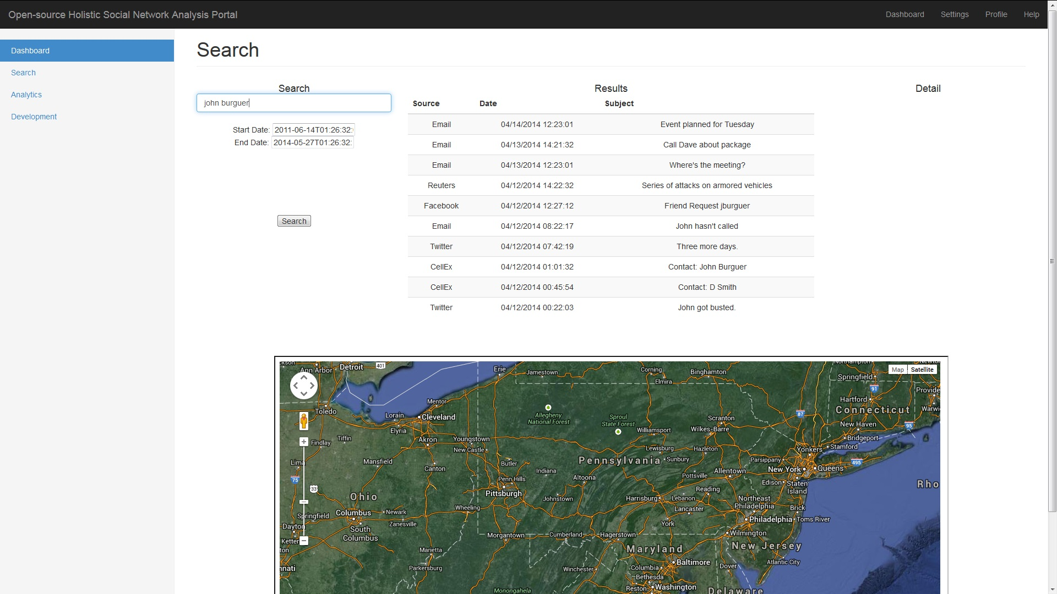
Implementation Results Pane
Notes:
This view shows the Search pane with results from a query displayed. The results table shows the source, date and subject (or brief description) of each message that matches the query.

Slide 12
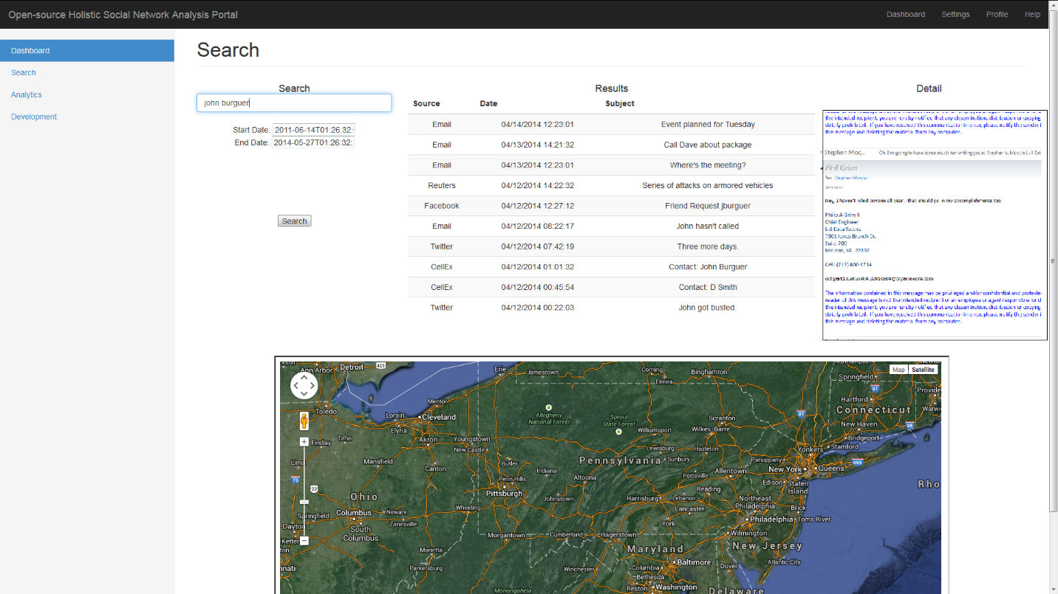
Implementation Detail View
Notes:
This view shows the result of clicking on a message in the results table. The selected message is displayed in a scrollable pane for the analyst to read.

Slide 13
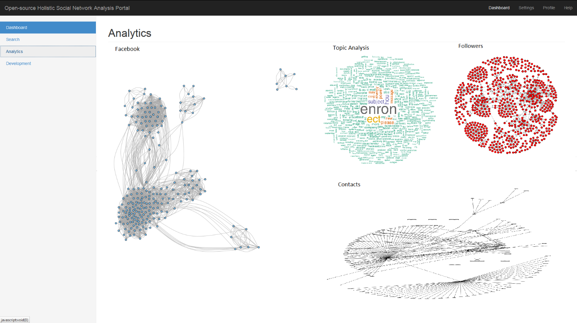
Implementation Analytics Pane
Notes:
The Analytics pane provides a space for the analyst to perform and display various types of analytics on the entire data set or on query results. Analytics can be developed and deployed from the development pane, and will show up here on the Analytics pane.
This screenshot shows several example analytics that were created and deployed from the RStudio server in the Development pane. The first analytic is a Facebook friends graph for a selected suspect. The second is a topic analysis word cloud over all of the text data in the data store. The Followers analytic shows the relationships between suspects as they are represented in Twitter followers. The final analytic is a graph of e-mail contacts between suspects.

Slide 14
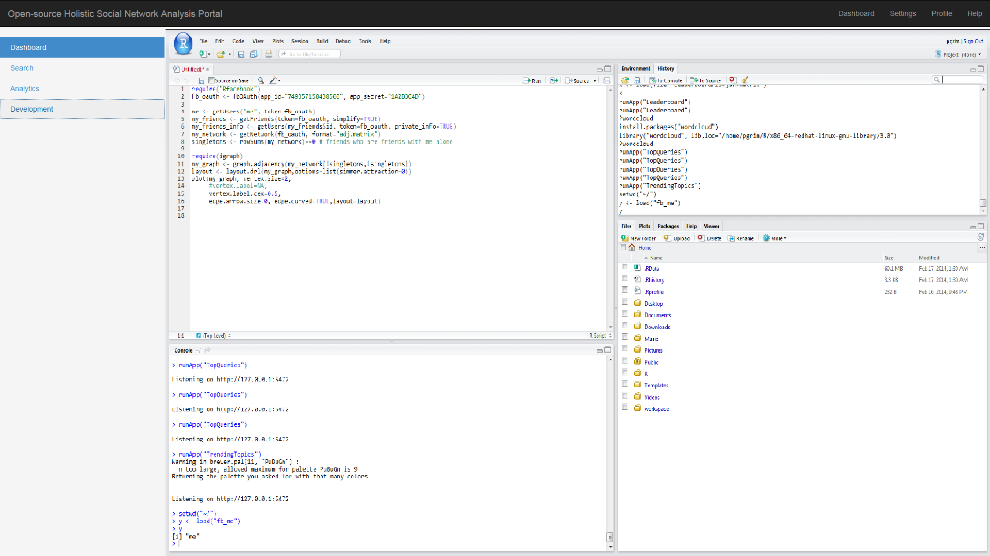
Implementation Development Pane
Notes:
This pane exposes the RStudio server development interface. Analysts can use this development environment to create, test, and deploy many different custom analytics.

Slide 15
Conclusion
The Open-source Holistic Social Network Analysis Portal is a very simple example of how the concepts of Business Intelligence can be developed to serve the cause of law enforcement and counter-terrorism.
The demo application shown here has features in common with various software applications currently in use in the intelligence community and law enforcement agencies.
These applications have allowed agencies to identify and capture terrorists and criminals, and helped to avert attacks against civilian and military targets around the world.

